Slide 1
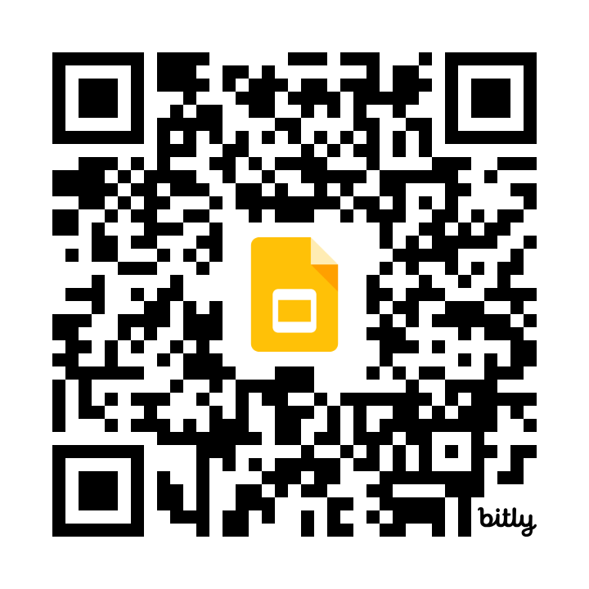
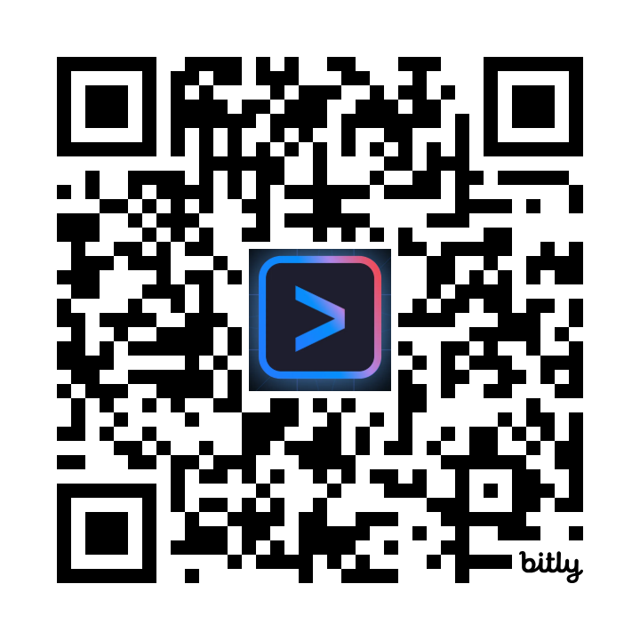
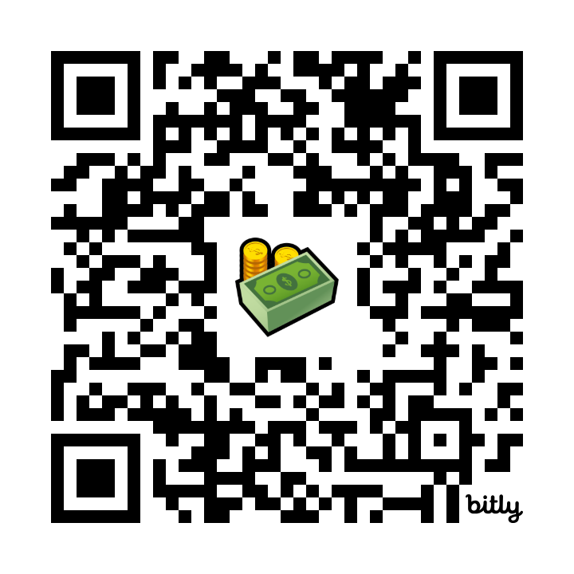
These very slides (everything explained step by step).
The one link to link them all..
The ADK workshop (a single page on GitHub): download ADK, Gemini CLI, and get to the action!
Get credits from Google Cloud! No credit card required! Your resources stay with you after this workshop!
GMail required.
goo.gle/adk-cli-workshop
goo.gle/adk-cli-slides
goo.gle/adk-cli-credits
Notes:
Trygcp dynamic link on page 6.
Prompt to the right: “”A number of developers are really excited for a hands-on workshop with their laptops. They're smiling and come from diverse background.”””
Self link: https://docs.google.com/presentation/d/1kGxf44SddFt4jUJJuMLlXwezgdX4352Q49Jwqg50u0E/edit#slide=id.g337964b5ba0_1_193 -> go/onramp-deck-public
Prompt Imagevn 4: “A diverse crowd of developers with their laptop at a conference/workshop is super happy and does some hurray!”

Slide 2


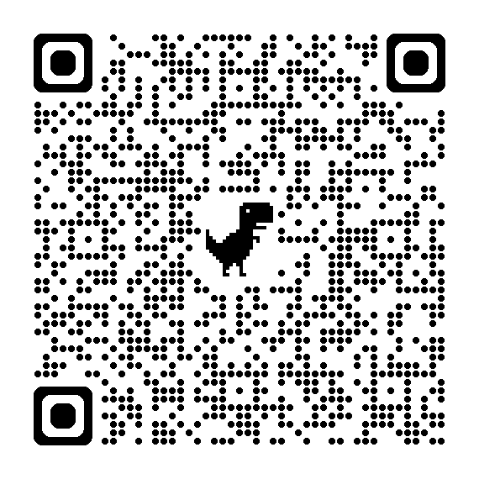
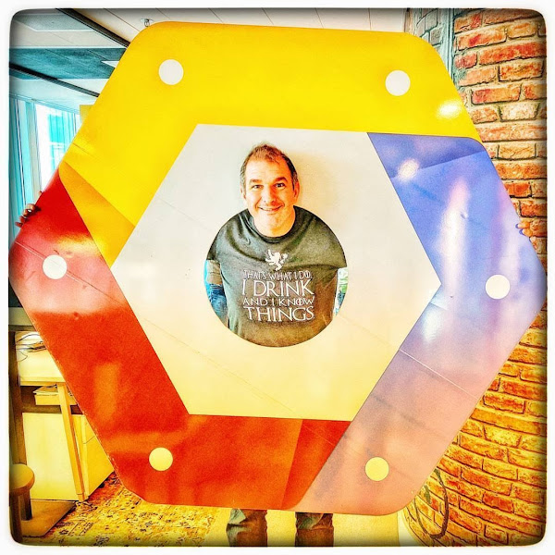
Reclaim your $$ credits
Riccardo Carlesso
Developer Advocate
goo.gle/adk-cli-slides
Notes:
Trygcp dynamic link on page 6.
Prompt to the right: “”A number of developers are really excited for a hands-on workshop with their laptops. They're smiling and come from diverse background.”””
Self link: https://docs.google.com/presentation/d/1kGxf44SddFt4jUJJuMLlXwezgdX4352Q49Jwqg50u0E/edit#slide=id.g337964b5ba0_1_193 -> go/onramp-deck-public
Prompt Imagevn 4: “A diverse crowd of developers with their laptop at a conference/workshop is super happy and does some hurray!”

Slide 3
Table of Contents
05 🏭 Workshop links
07 Reclaim credits
20 Gemini API Key (optional)
27 Gemini CLI installation

Slide 4
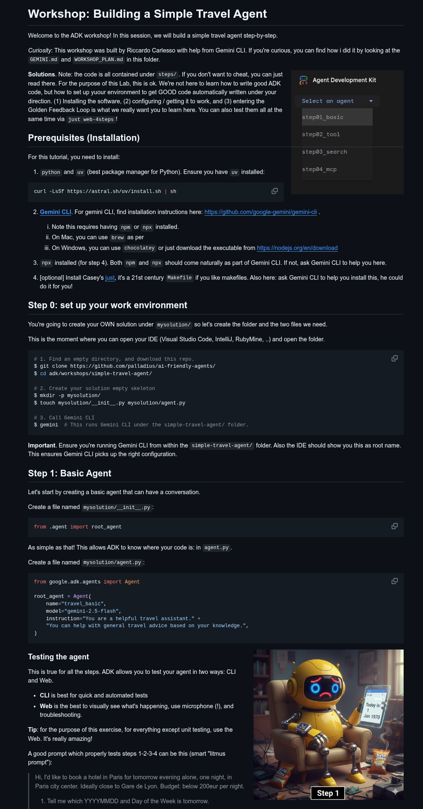
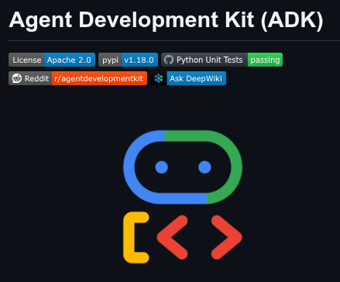

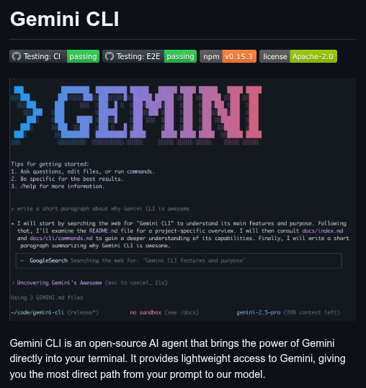
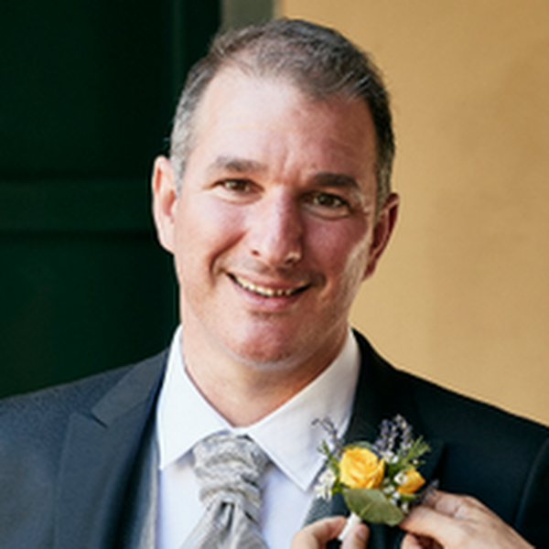
goo.gle/adk-cli-workshop
Notes:
Daniel concept: https://docs.google.com/document/d/1VnWm1IIYwK2fm8TkCdLRUoFX402wA-wqDt-y14LBDqE/edit?resourcekey=0-bo5Bc22pglQ27__3V2BpRQ&tab=t.0
Spealker notes:
[ricc] My codelab will walk you through an existing application, which is pretty TERRIBLE, and then slowly modernize it (create a docker file, push it to cloud run, set up CICD and all the way to a cloud function which calls gemini for some magic). The codelab is self paced, and you have a comfy web codelab to follow. This is the PAST/
[daniel] Daniel, OTOH, is the FUTURE. In 2049, OmegaCorp has taken over the world….

Slide 5
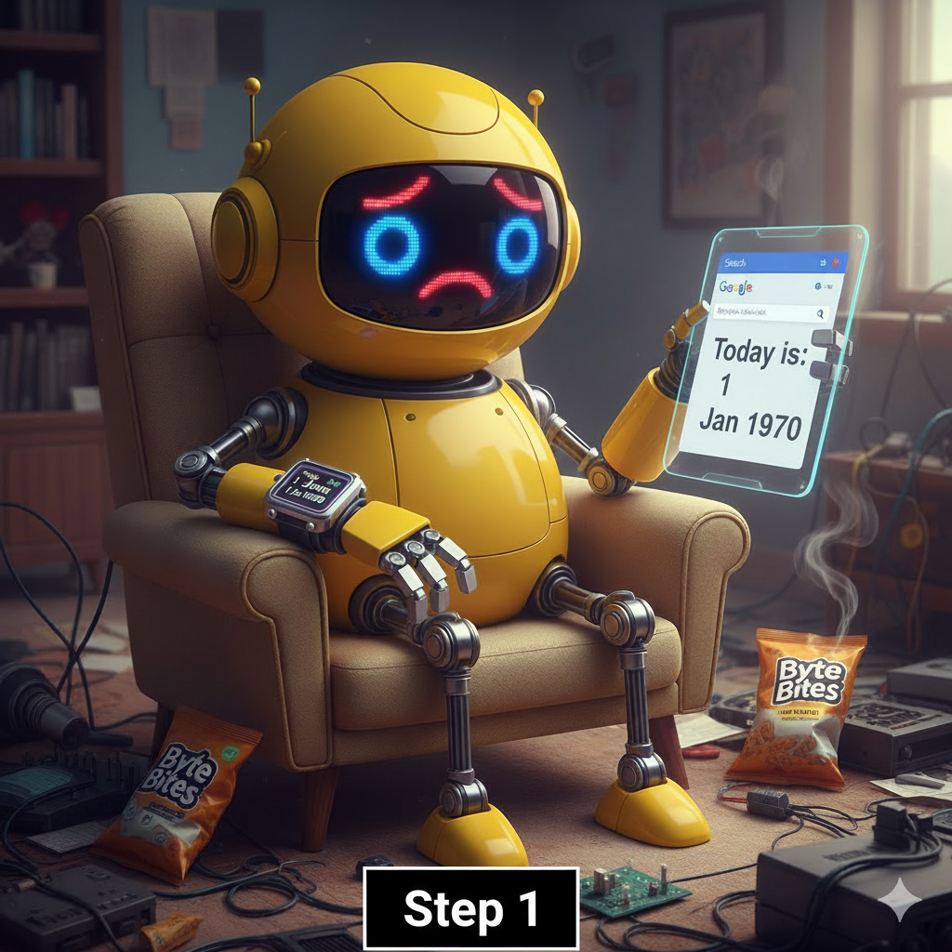
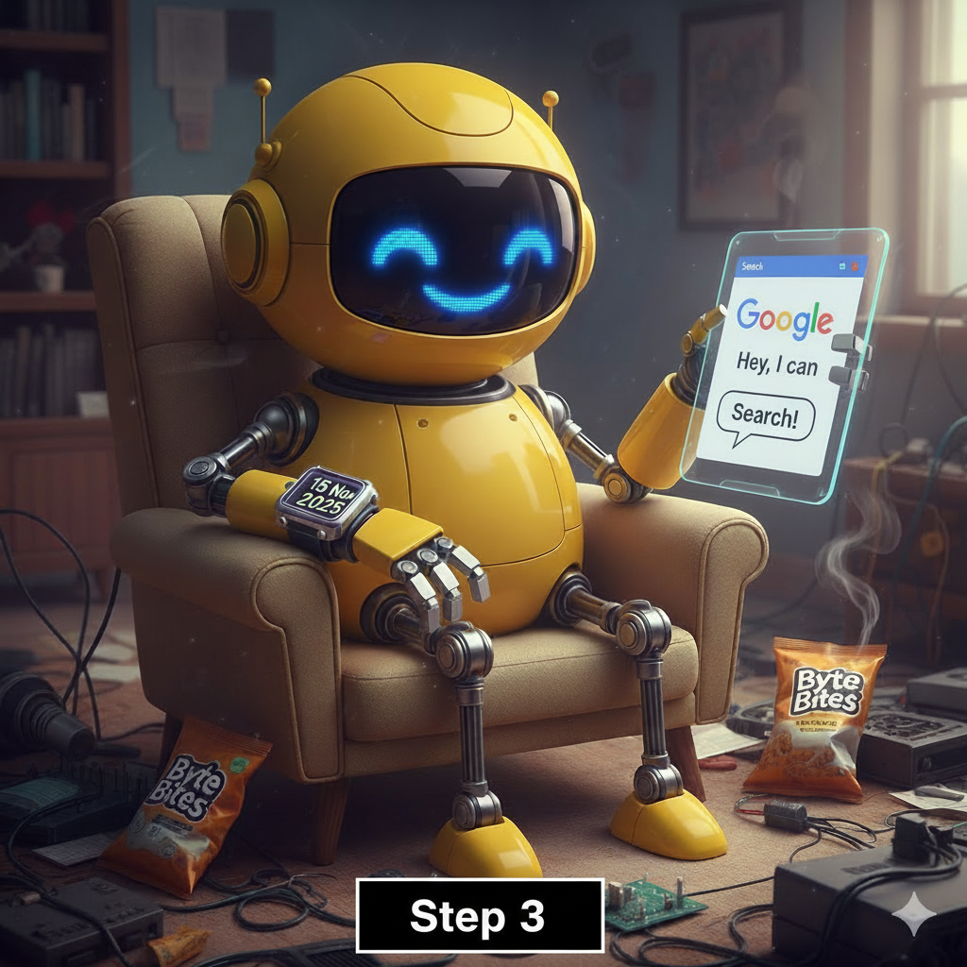
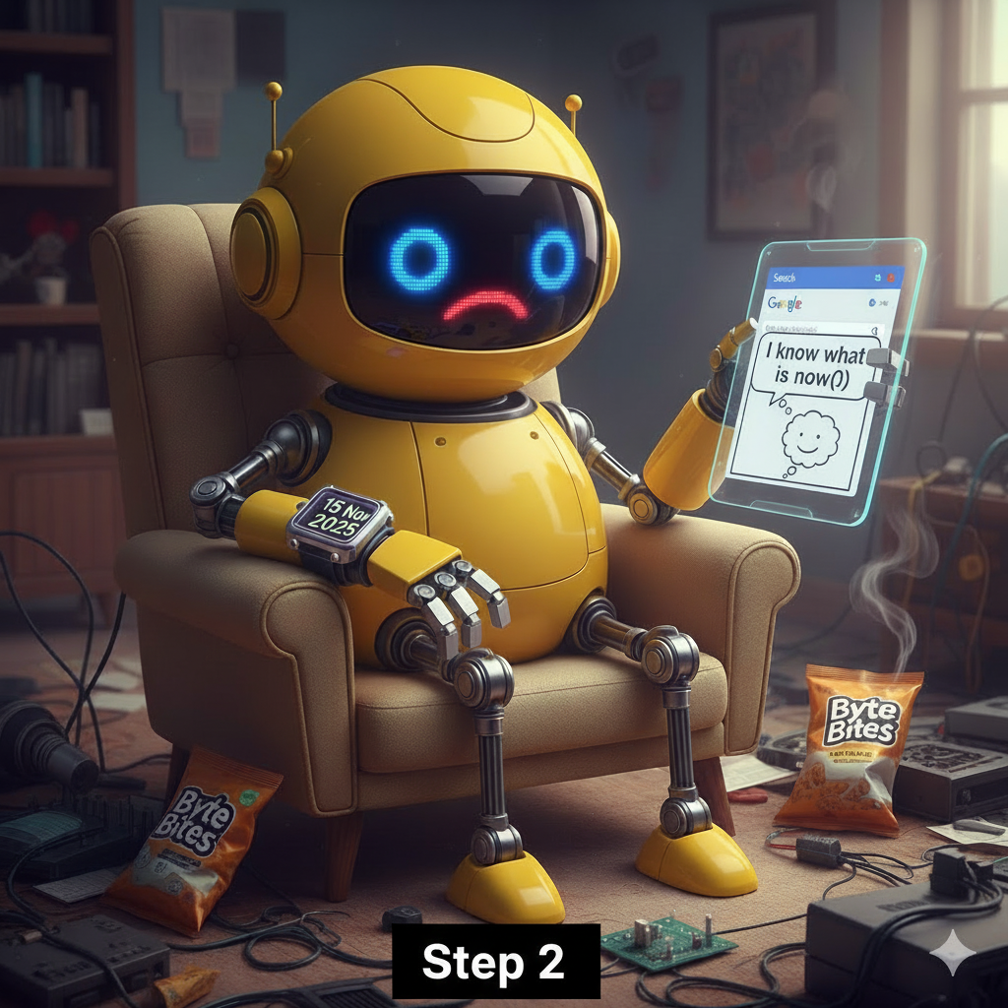
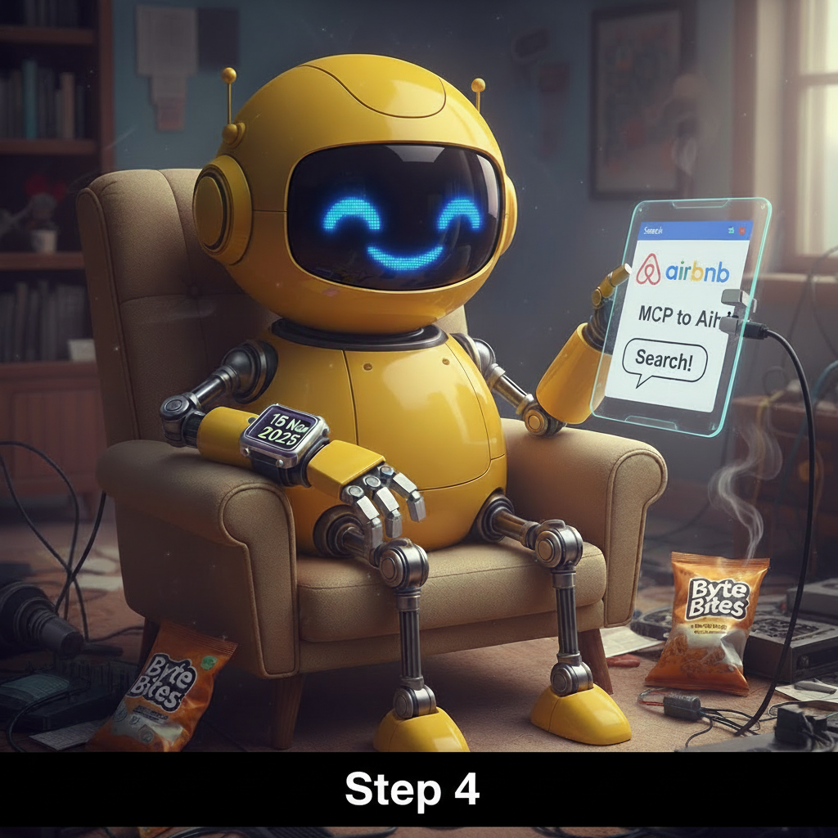
Welcome to today's __________ workshop!
hands-on

Slide 6

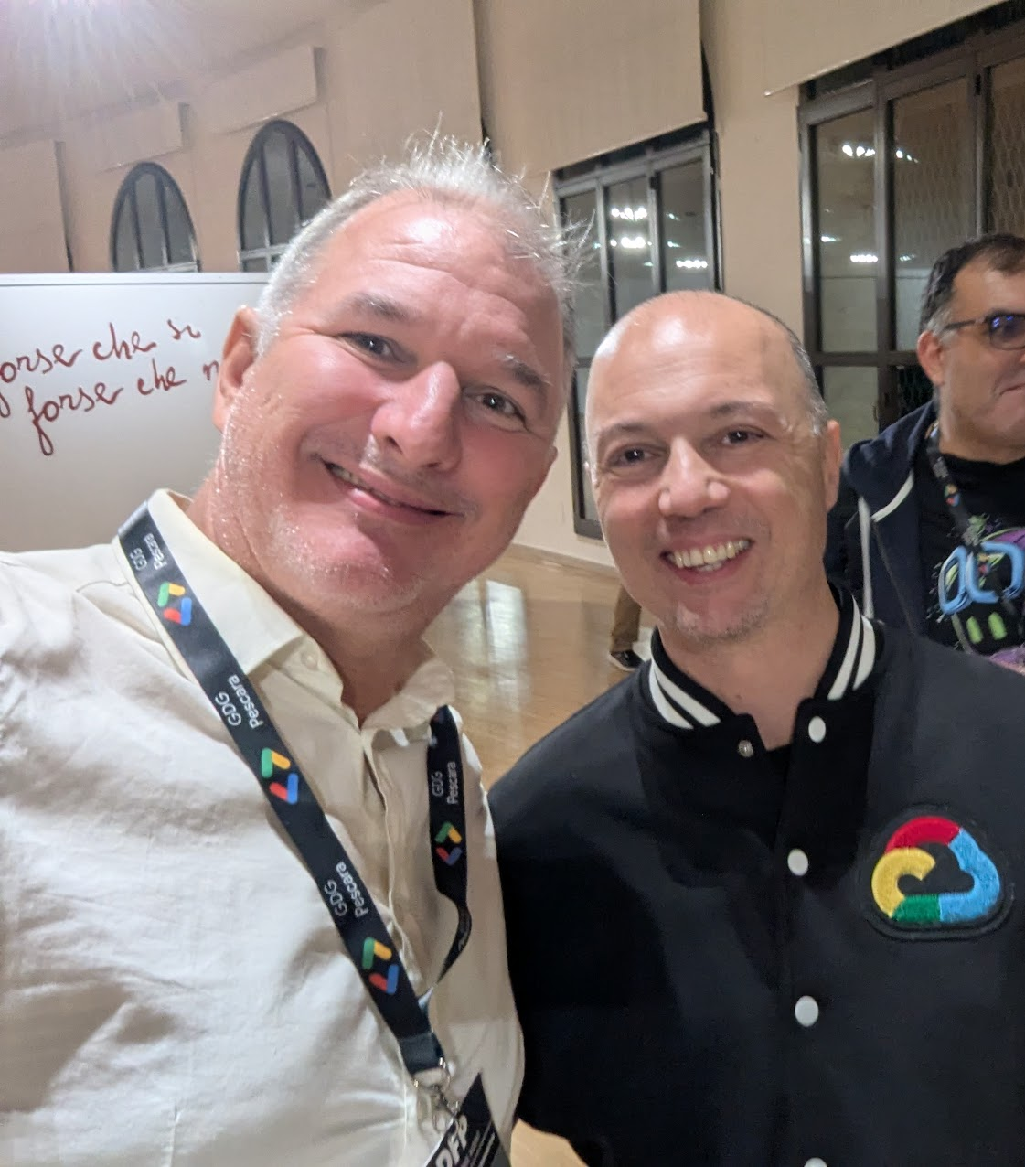
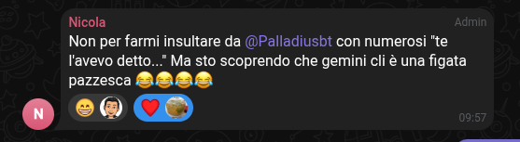
Dicono di Gemini CLI..
😎

Slide 7

You will use:
01
02
03
A personal Gmail account
School and business accounts cannot use today's workshop free credits.
A personal laptop
Ideally without restrictions on
network access.
The Chrome browser
Other browsers are supported,
but with a large group we want
to minimize variations.
Notes:
Troubleshooting suggestion for presenters - Incognito mode with third party cookies enabled has worked well to unblock some attendees.
Previous phrasing: School and business accounts are often restricted from using all or part of Google Cloud console.

Slide 8
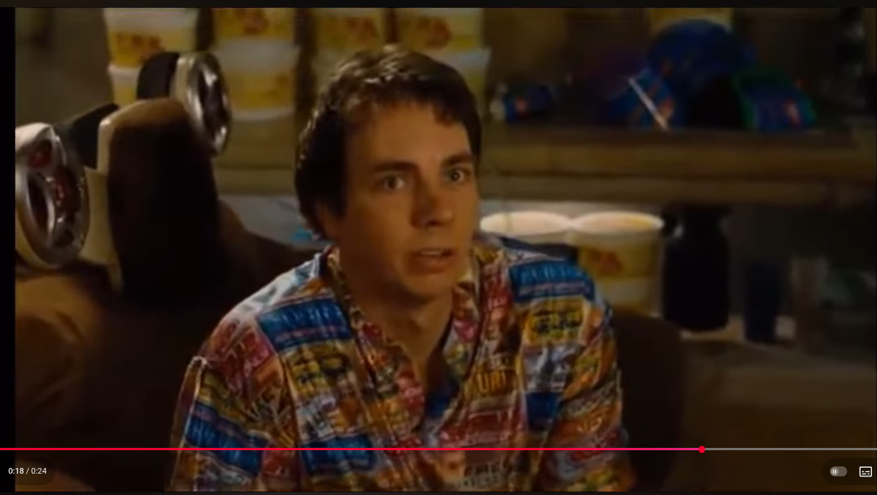
🇮🇹 Open this URL: 🇮🇹
I like money!
goo.gle/adk-cli-credits

Slide 9
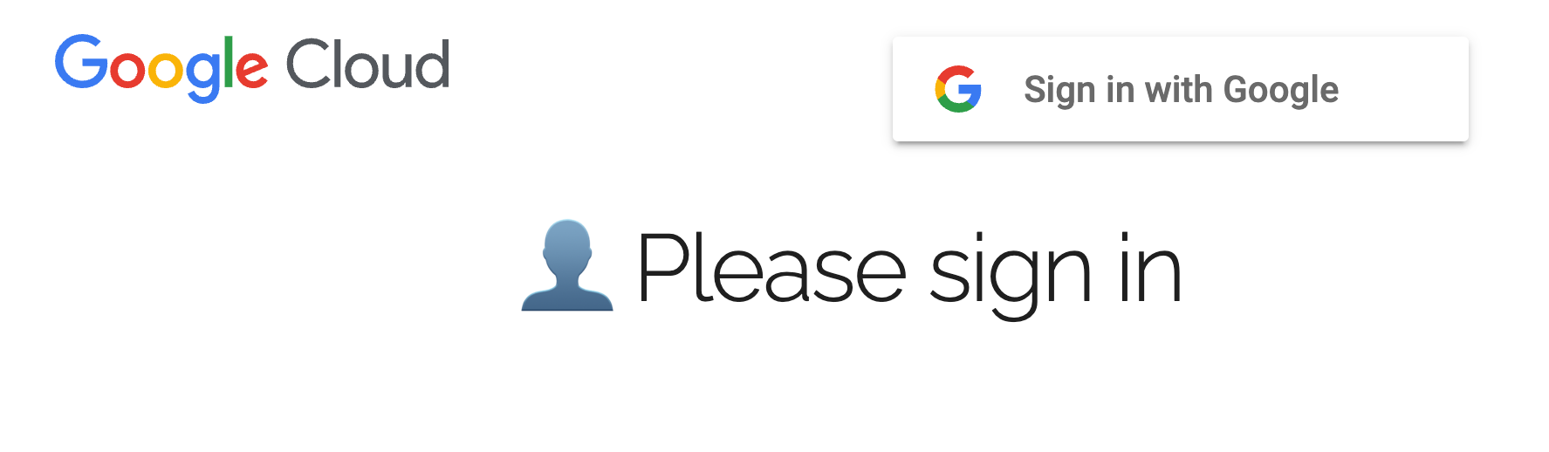
You will need to be signed in
Developers Labs
Click on “Sign in with Google” button

Slide 10
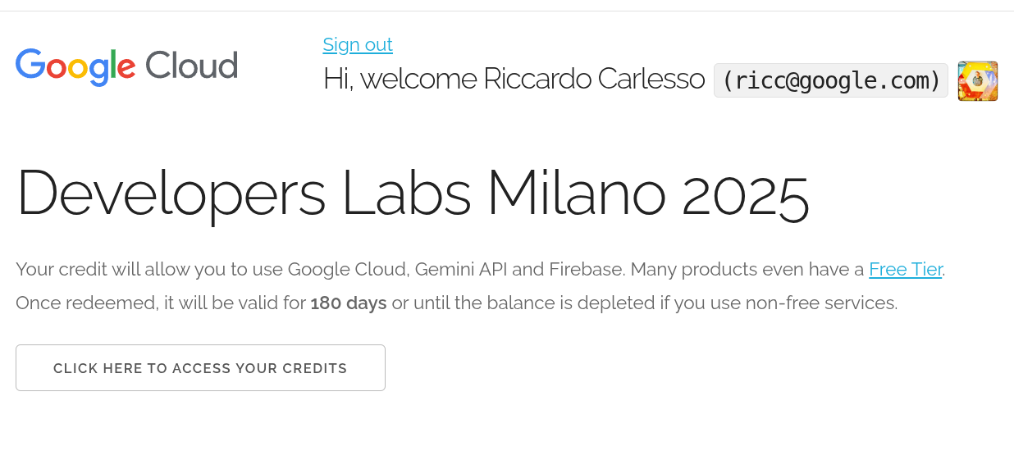
You should see a similar page. Click on this button.

Slide 11
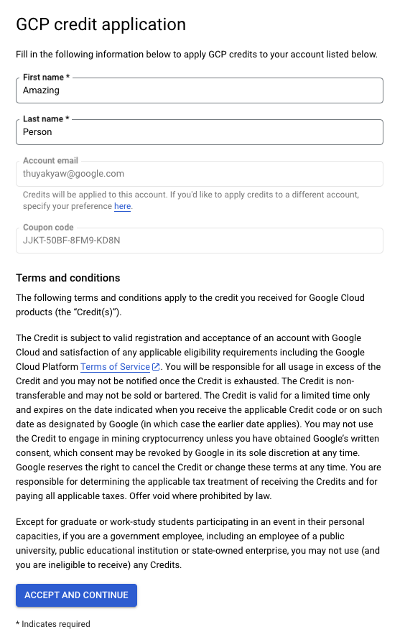
cloud-dev@gmail.com
Make sure that you are applying for the correct account
Click on “Accept and Continue” to proceed
Notes:
[ricc] This “accept and continue” could fail. The #1 reason for failure is that email already got a similar coupon before. Please ask the audience if they can’t make it through the end, and collect feedback for the onramp team.

Slide 12
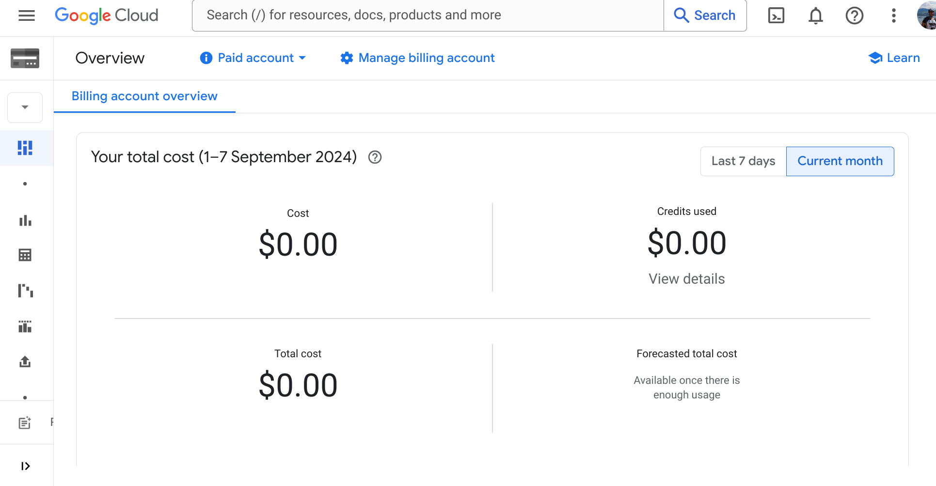
If you see a Billing page, click on top left “Google Cloud” until you see a Project selector on top left
Notes:
[ricc] This “accept and continue” could fail. The #1 reason for failure is that email already got a similar coupon before. Please ask the audience if they can’t make it through the end, and collect feedback for the onramp team.

Slide 13
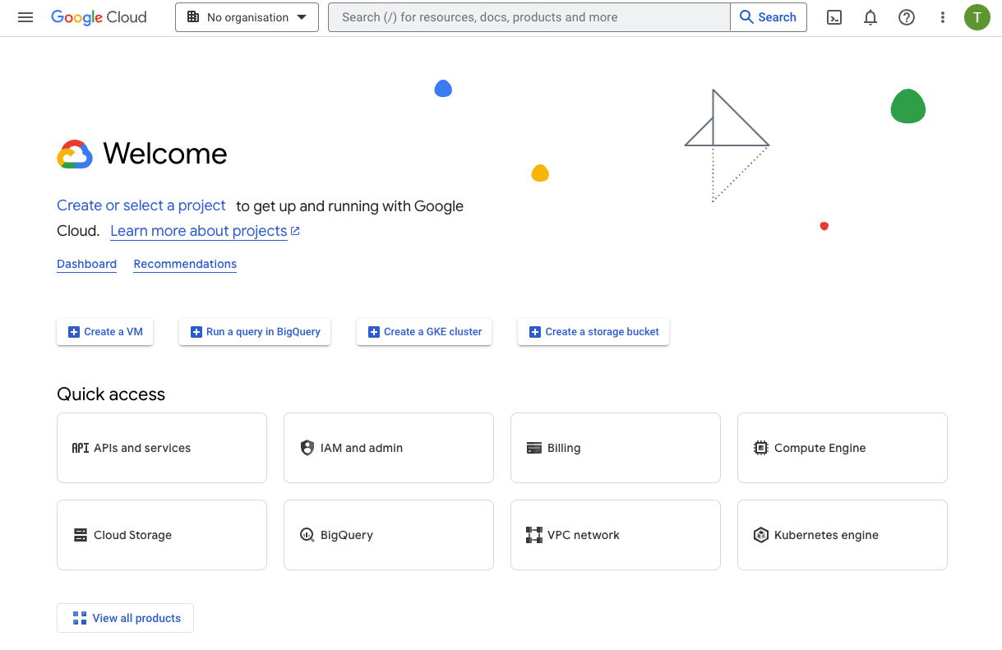
Go to console.cloud.google.com
Click on this dropdown menu
‼️ If you can’t see this dropdown, click first on the colorful logo
Notes:
If attendees get stuck at this stage, note that the project selector will not show up right after redeeming a credit.
The user will end up on a billing page and have to navigate to any other page (by clicking the Google Cloud logo for example), then continue following the steps.

Slide 14
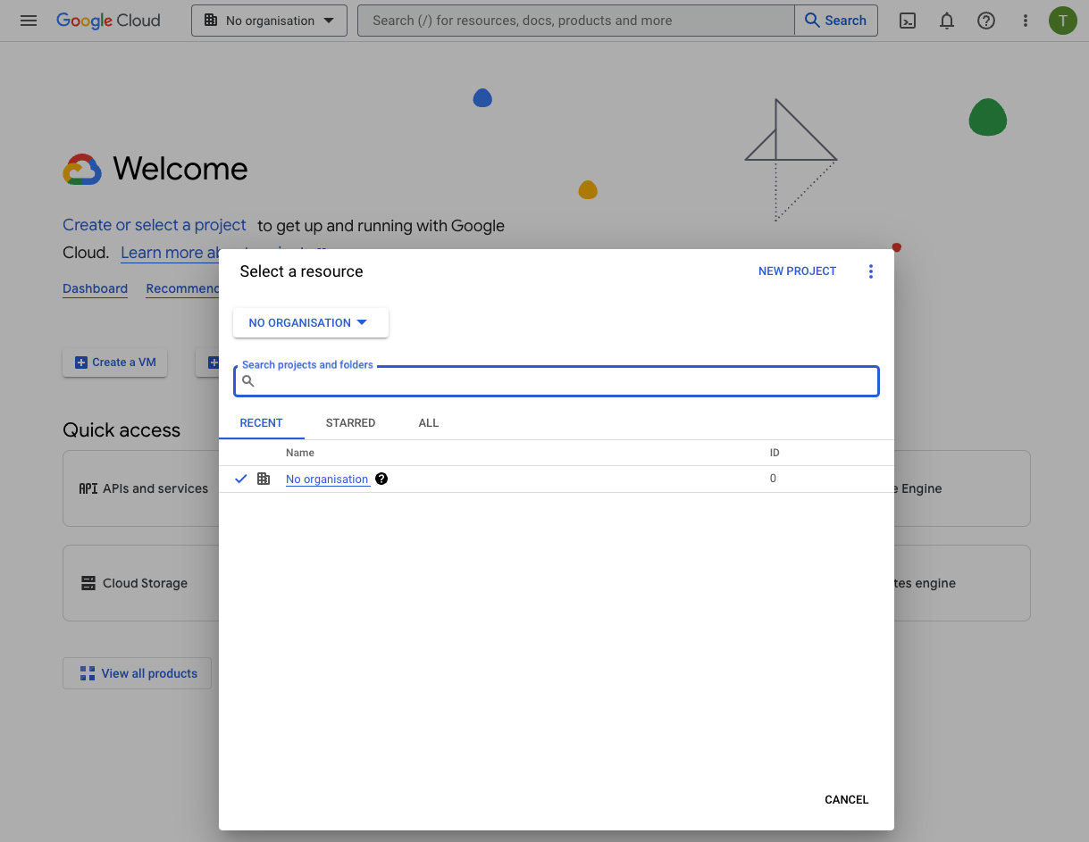
Create a new project (skip if you already created one)
Click on “New Project”

Slide 15
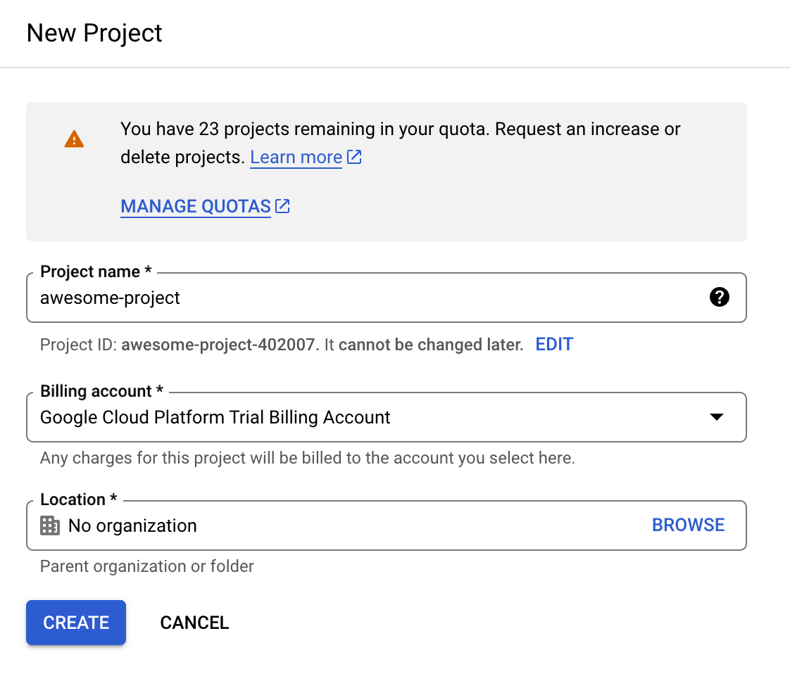
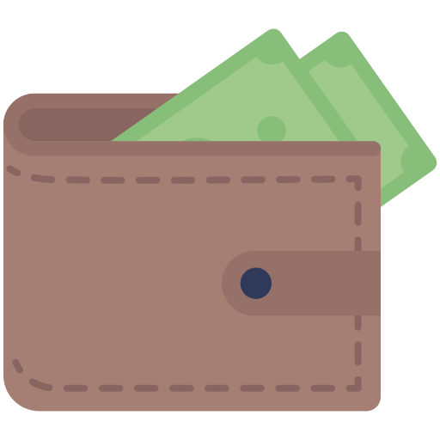
Creating a new project (skip if you already created one)
Name your project, eg “Google Hackathon”
💵 Select “trial billing account” (if it shows up*)
(*) This is important, as it connects your project to your new 5💲wallet
Select “No Organization” (if Location field shows up)
Click “CREATE”
Notes:
[Thu Ya]: There is a chance that “Billing account” dropdown doesn’t show up in this step. In this case, you have to check the “Billing” from the attendee’s cloud console to know whether they have redeemed the OnRamp credit successfully. If they have redeemed (there is a GCP Trial Billing Account in their Billing), a manual linking might be required. If the billing account is not there, they might have redeemed using another account, please ask them confirm the email address.

Slide 16
Creating a new project (Skip if you already have one)
If you can’t choose “No organization”, you might be in trouble.
One person from unimo.it was.

Slide 17
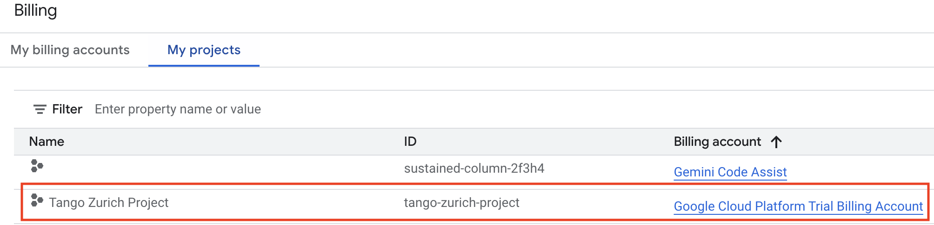
Check that your project is billed correctly
Search for Billing or go to https://console.cloud.google.com/billing
Click on My projects tab
Make sure your project is associated with the Google Cloud Platform Trial Billing Account

Slide 18
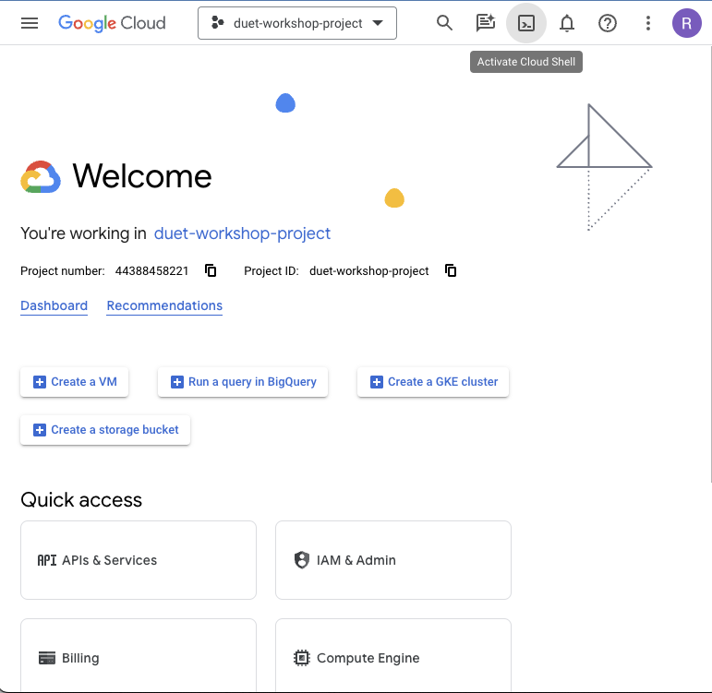
Open Cloud Shell
Note: It may take a minute or two to start your VM

Slide 19



If you don't have a project set up yet, raise your hand for a TA to help you. 🙋‍♂️🙋🏾‍♀️

Slide 20
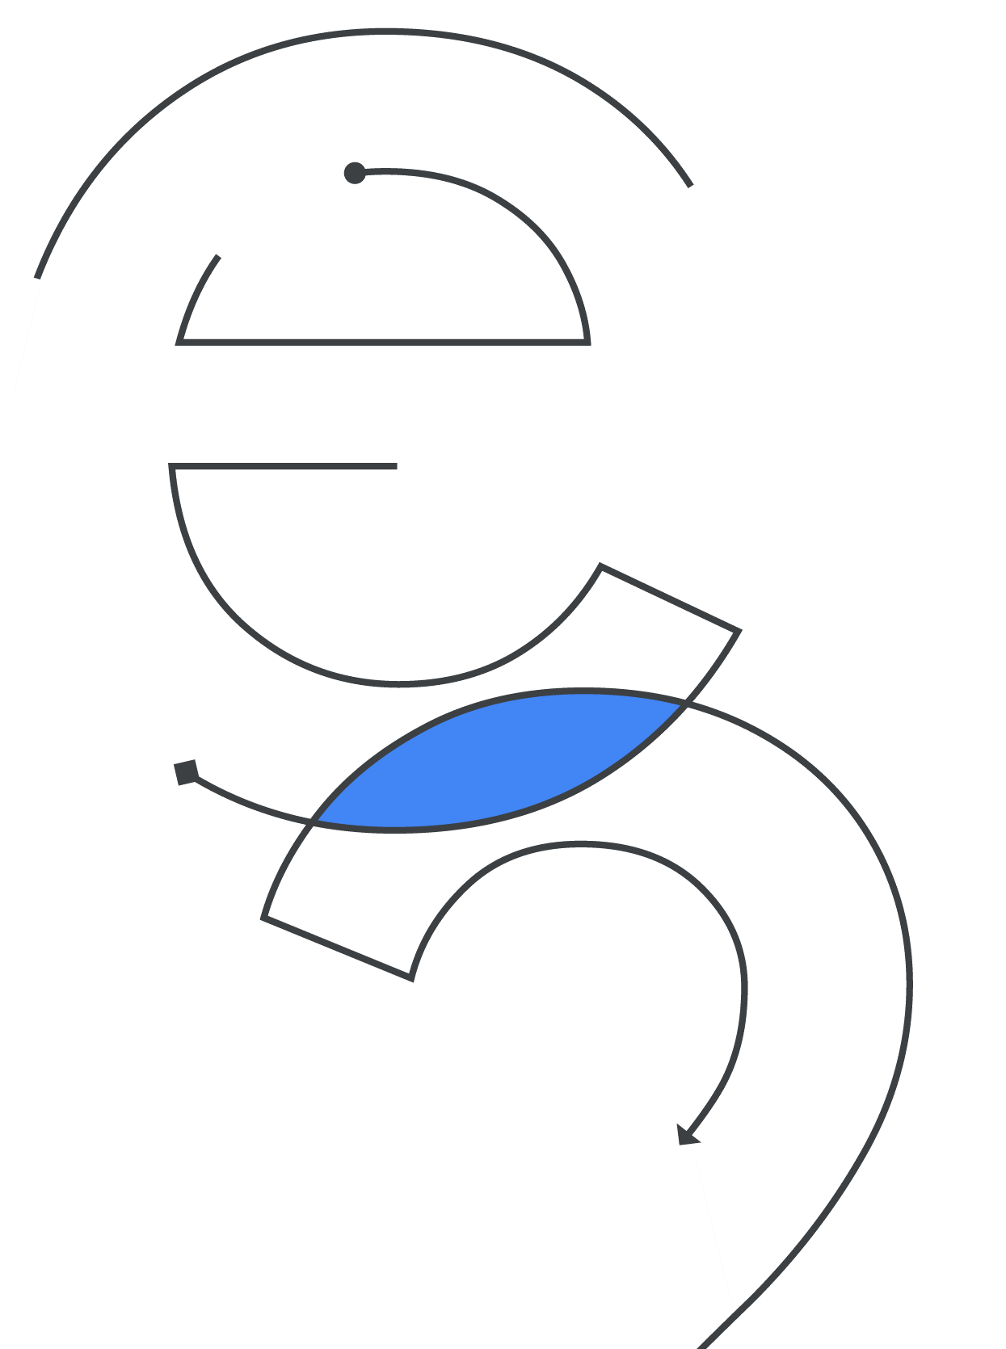
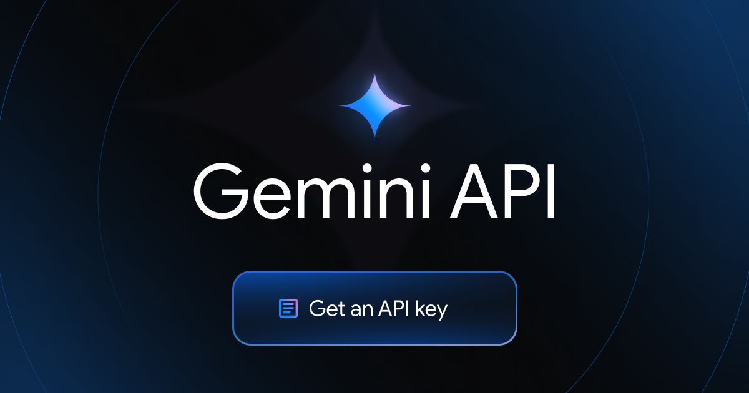
(optional)

Slide 21
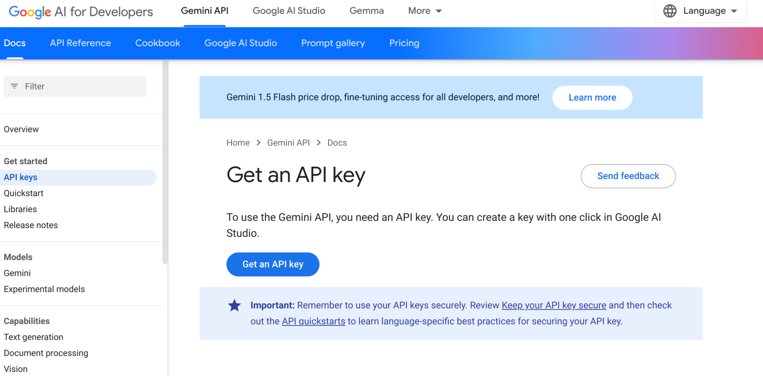
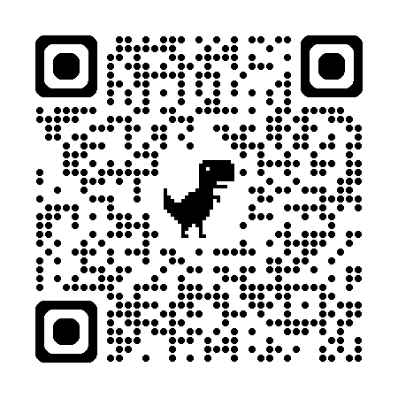
https://ai.google.dev/gemini-api/docs/api-key

Slide 22
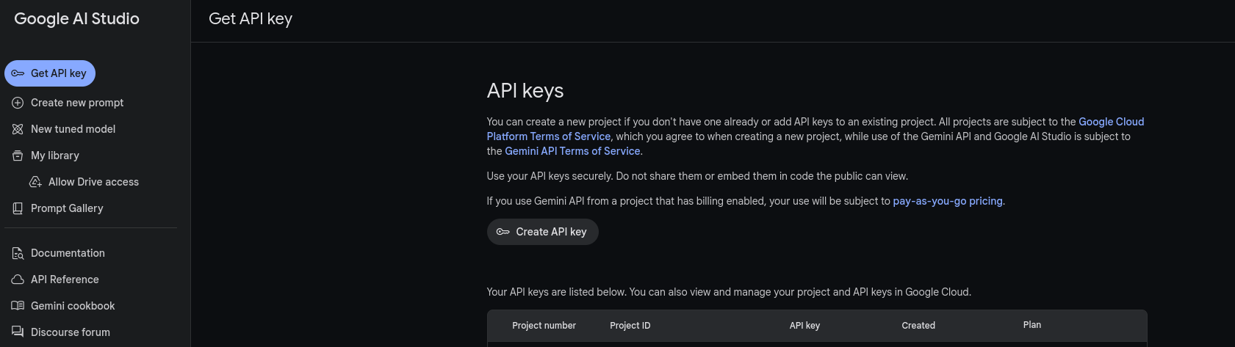

Slide 23
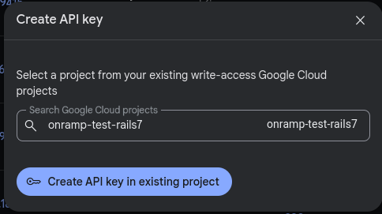
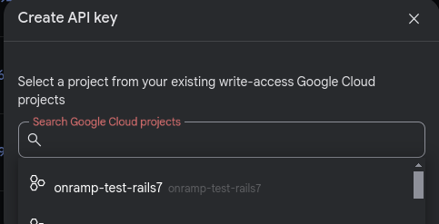
2. Click to create key within that project
1. Select project

Slide 24
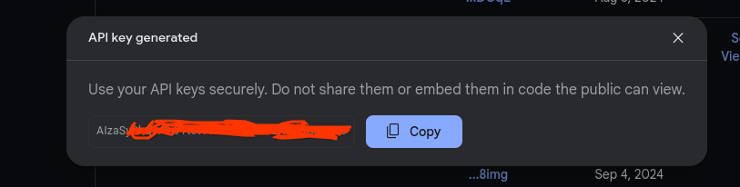
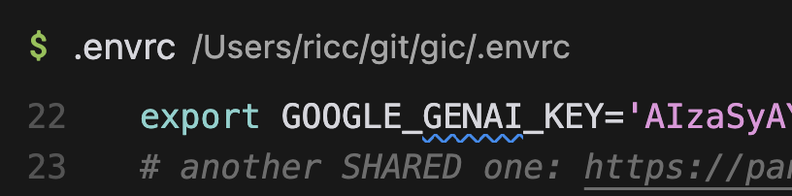
Tip: Usually it starts with “AIza”

Slide 25

Congratulations !
You are all set to start developing with Google Cloud
and invoking Gemini!

Slide 26

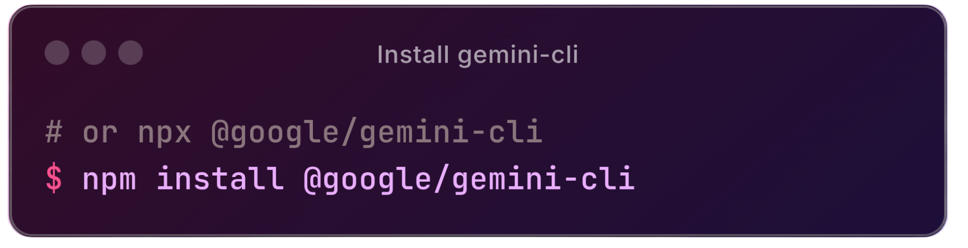



> Gemini CLI
Proprietary & Confidential

Slide 27
Dicono di Gemini CLI..
(scusate il momento faceto)
😎

Slide 28
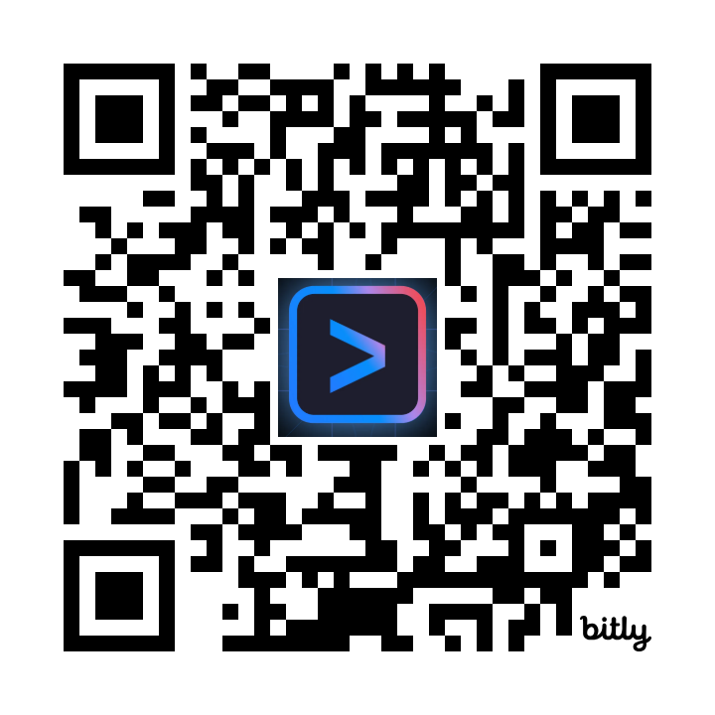
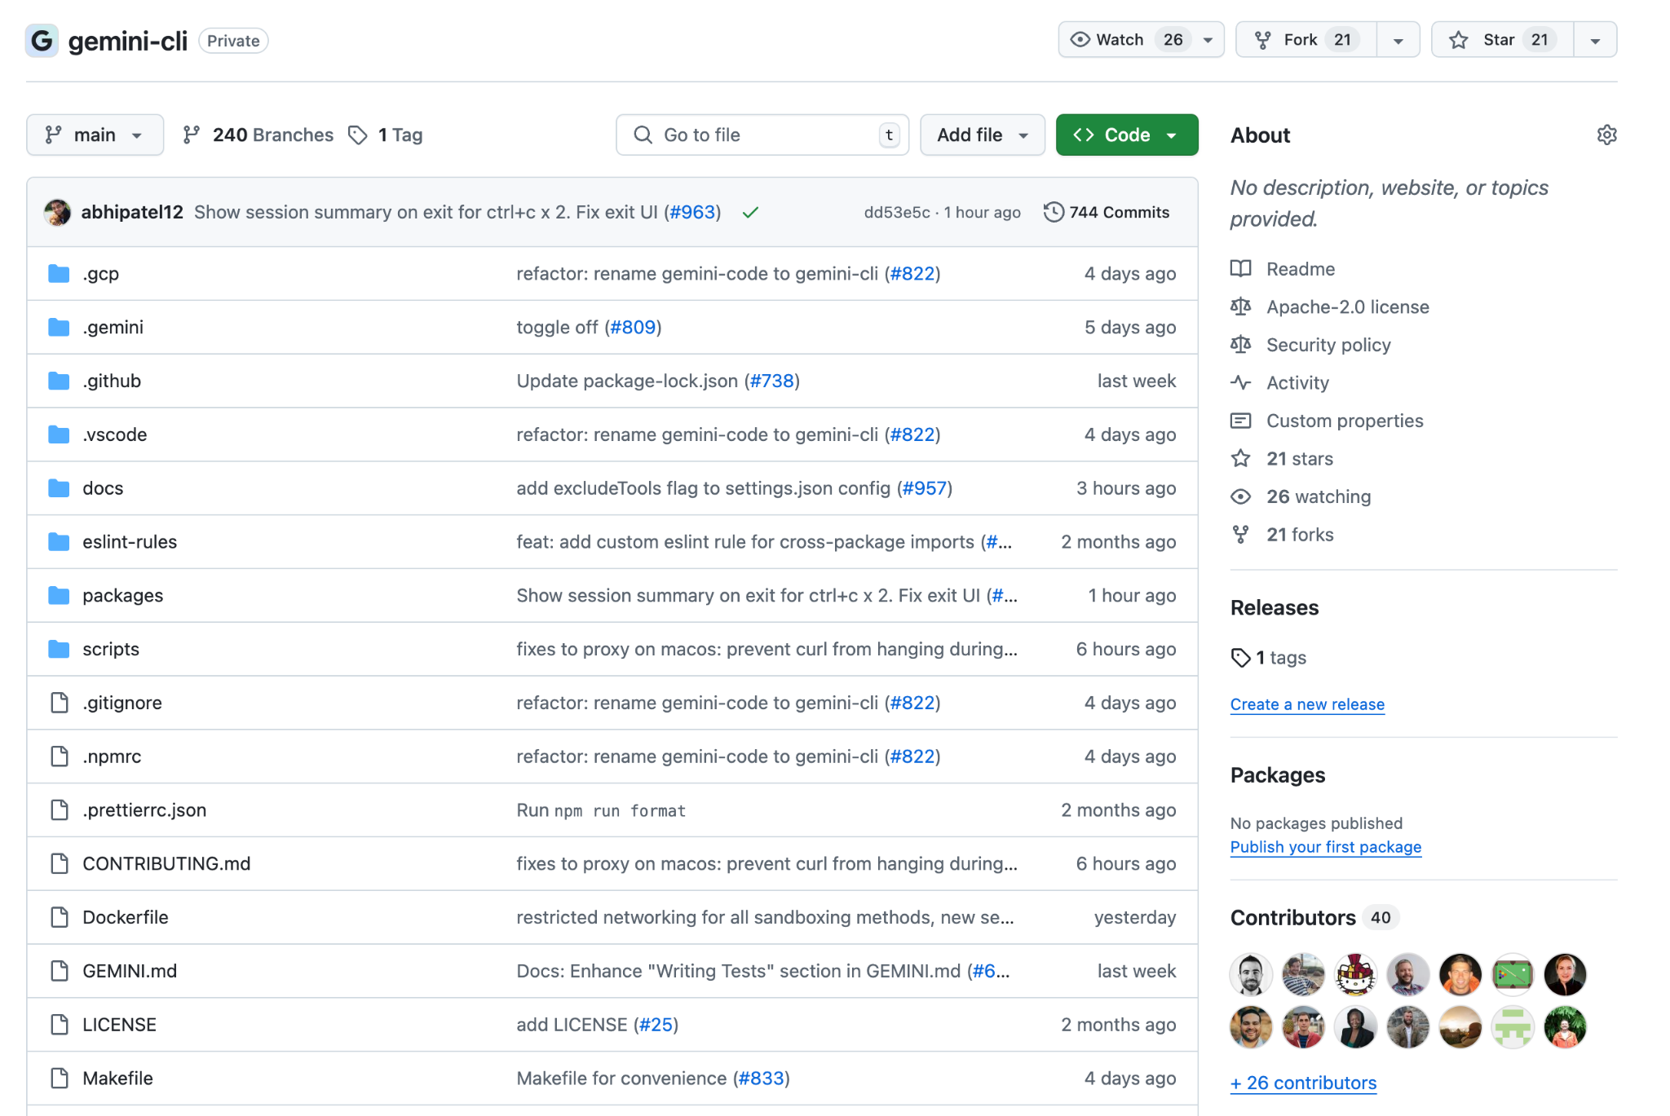
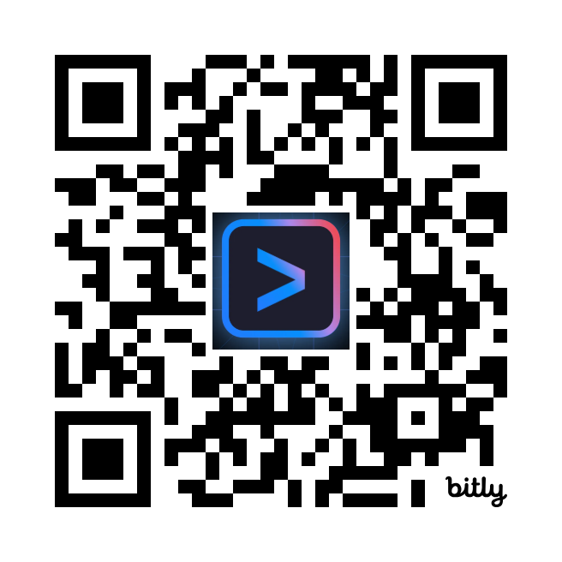
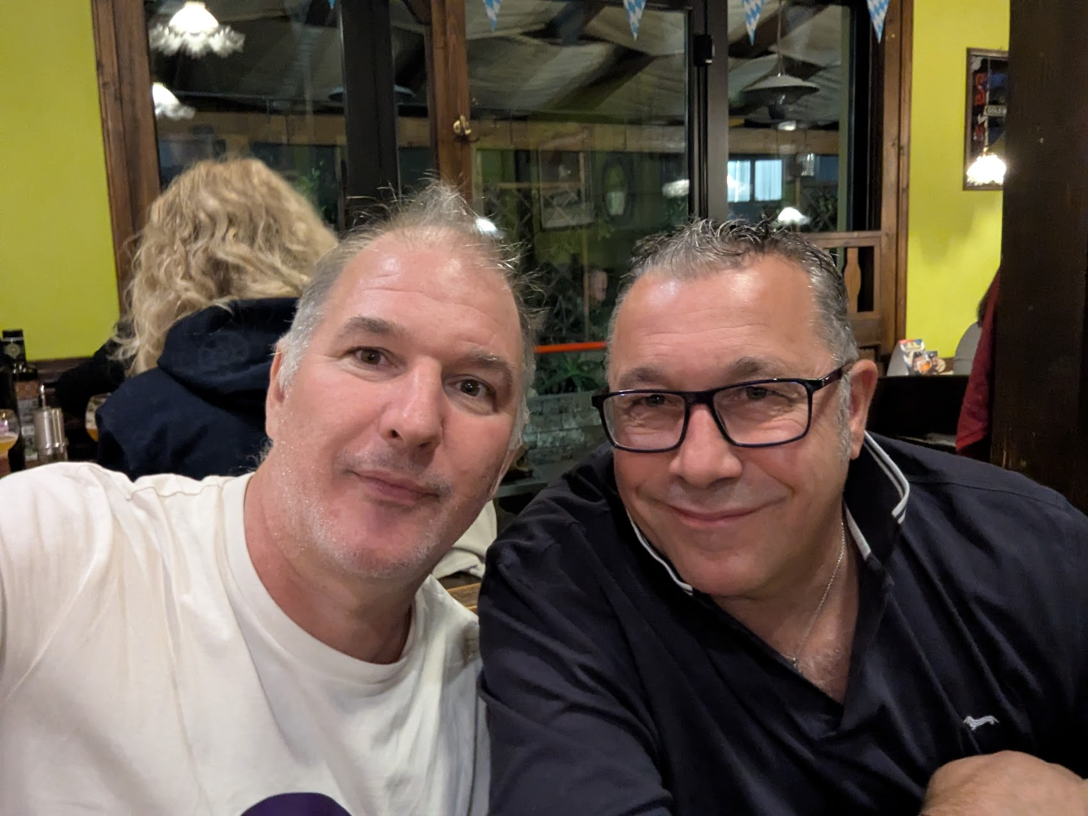
Open Source
goo.gle/gemini-cli
goo.gle/giancarlo

Slide 29
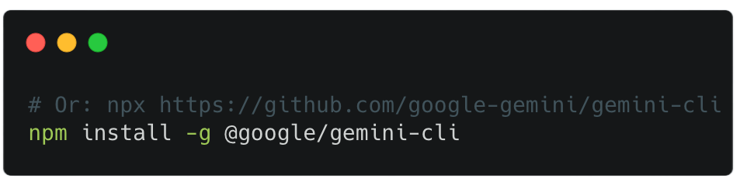
Installation
npm install -g @google/gemini-cli

Slide 30

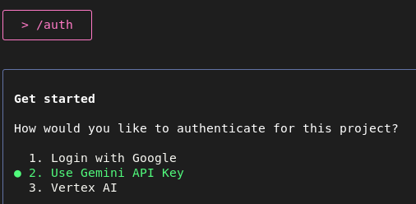
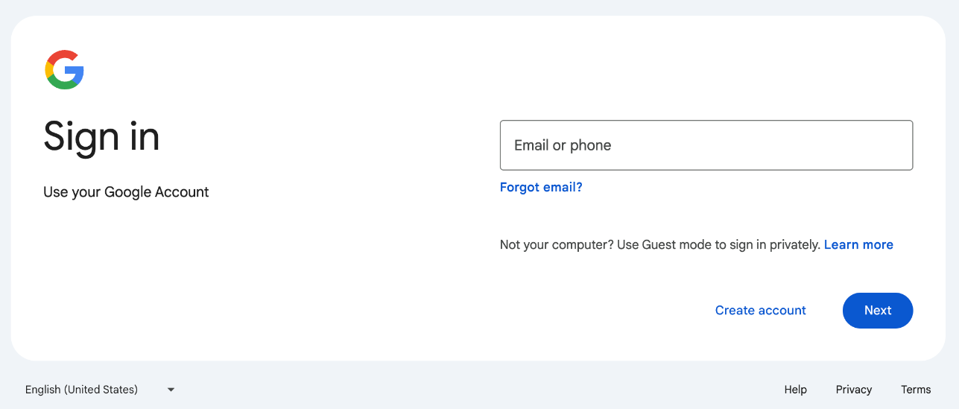
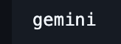
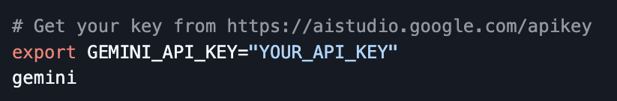
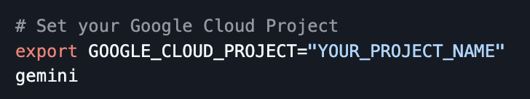
2. Authentication: /auth
Choose “Login for Google”

Slide 31

Thank you
Riccardo Carlesso
Developer Advocate
Notes:
Make sure to follow these steps, or delete your project to avoid incurring costs from resources deployed during today’s session

Slide 32

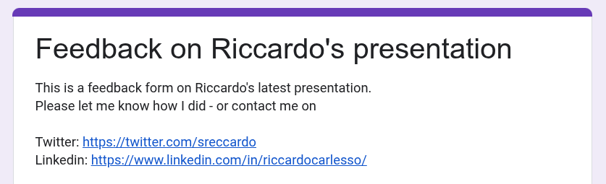
https://docs.google.com/forms/d/19x1Dreko6ruoxJhXuNp2TZFDlG45hjaoZAc3nhwcado/viewform

Slide 33



You like Ruby too?
Rubycon Italy
the premier Ruby conference in the heart of Italy 🇮🇹
https://rubycon.it/
8 May 2026

